Slide 1
Algorithm Design & Analysis
Nahidul Islam
Lecturer, Dept. of CSE
DCC, Dhaka.

Slide 2
Introduction
Text Book:
Algorithm Design and Its Application
Mst. Jannatul Ferdousi Ara
Sabiha Sultana
Shamima Sultana
Reference Book:
Computer Algorithms
Sahni Horowit
INTRODUCTION TO ALGORITHMS (3rd edition)
THOMAS H. CORMEN
CHARLES E. LEISERSON
RONALD L. RIVEST
CLIFFORD STEIN

Slide 3
Introduction
Learn general approaches to algorithm design
Divide and conquer
Greedy method
Dynamic Programming
Basic Search and Traversal Technique
Basic Sorting Technique
Back Tracking
Linear Programming
Graph Algorithms
NP Problem

Slide 4
What is Algorithm
An algorithm is a self-contained step-by-step set of operations to be performed.
Describe: in natural language / pseudo-code / diagrams / etc.
Criteria to follow:
Input: Zero or more quantities (externally produced)
Output: One or more quantities
Definiteness: Clarity, precision of each instruction
Effectiveness: Each instruction has to be basic enough and feasible
Finiteness: The algorithm has to stop after a finite (may be very large) number of steps

Slide 5
Example: What is an Algorithm?
Problem: Input is a sequence of integers stored in an array.
Output the minimum.
INPUT
Algorithm
OUTPUT
instance
m:= a[1];
for I:=2 to size of input
if m > a[I] then m:=a[I];
return s
25, 90, 53, 23, 11, 34
11
m
Data-Structure

Slide 6
Define Problem
Problem:
Description of Input-Output relationship
Algorithm:
A sequence of computational step that transform the input into the output.
Data Structure:
An organized method of storing and retrieving data.
Our task:
Given a problem, design a correct and good algorithm that solves it.

Slide 7
The Study of Algorithm
How to devise algorithms
How to express algorithms
How to validate algorithms
How to analyze algorithms
How to test a program

Slide 8
Importance of Analyze Algorithm
Need to recognize limitations of various algorithms for solving a problem.
Need to understand relationship between problem size and running time.
When is a running program not good enough?
Need to learn how to analyze an algorithm's running time without coding it.
Need to learn techniques for writing more efficient code.
Need to recognize bottlenecks in code as well as which parts of code are easiest to optimize.

Slide 9
What do we analyze about them?
Correctness
Does the input/output relation match algorithm requirement?
Amount of work done (aka complexity)
Basic operations to do task
Amount of space used
Memory used
Simplicity, clarity
Verification and implementation.
Optimality
Is it impossible to do better?

Slide 10
Analyze Algorithm: The Searching Problem
Problem: given a group of n numbers, determine the k^{th} largest
Algorithm 1
Store numbers in an array
Sort the array in descending order
Return the number in position k

Slide 11
Analyze Algorithm: The Searching Problem
Algorithm 2
Store first k numbers in an array
Sort the array in descending order
For each remaining number, if the number is larger than the k^{th} number, insert the number in the correct position of the array
Return the number in position k
Which algorithm is better?

Slide 12
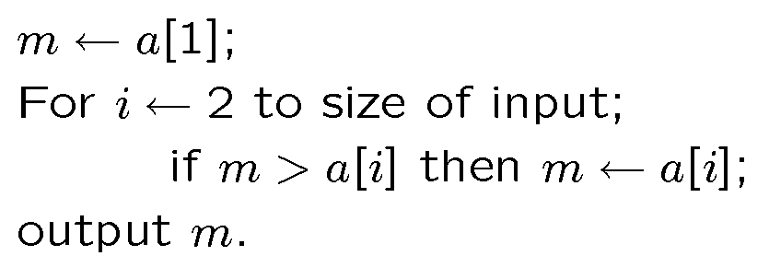
Example Algorithm A
Problem: The input is a sequence of integers stored in array.
Output the minimum.
Algorithm A

Slide 13
Example Algorithm B
This algorithm uses two temporary arrays.
copy the input a to array t1;
assign n ← size of input;
While n > 1
For i ← 1 to n /2
t2[ i ] ← min (t1 [ 2*i ], t1[ 2*i + 1] );
copy array t2 to t1;
n ←n/2;
3. Output t2[1];

Slide 14
Visualize Algorithm B
34
6
5
9
20
8
11
7
Loop 1
6
5
8
7
Loop 2
5
7
Loop 3
5

Slide 15
Example Algorithm C
Sort the input in increasing order. Return the
first element of the sorted data.
34
6
5
9
20
8
11
7
black
box
Sorting
5
6
7
8
9
11
20
34

Slide 16
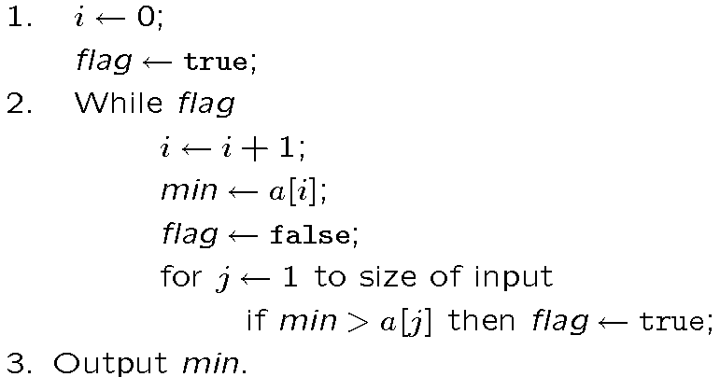
Example Algorithm D
For each element, test whether it is the minimum.

Slide 17
Which algorithm is better?
The algorithms are correct, but which is the best?
Measure the running time (number of operations needed).
Measure the amount of memory used.
Note that the running time of the algorithms increase as the size of the input increases.

Slide 18
What do we need?
Correctness: Whether the algorithm computes
the correct solution for all instances
Efficiency: Resources needed by the algorithm
1. Time: Number of steps.
2. Space: amount of memory used.
Measurement “model”: Worst case, Average case
and Best case.

Slide 19
Time vs. Size of Input
Measurement parameterized by the size of the input.
The algorihtms A,B,C are implemented and run in a PC.
Algorithms D is implemented and run in a supercomputer.
Let T_{k}( n ) be the amount of time taken by the Algorithm
4
T_{d}(n)
T_{c} (n)
Running time
(second)
T_{b} (n)
2
T_{a} (n)
0
500
1000
Input Size

Slide 20
Input Size
Time and space complexity
This is generally a function of the input size
E.g., sorting, multiplication
How we characterize input size depends:
Sorting: number of input items
Multiplication: total number of bits
Graph algorithms: number of nodes & edges
Etc

Slide 21
Complexity
The complexity of an algorithm is simply the amount of work the algorithm performs to complete its task.
Space complexity
How much space is required
Time complexity
How much time does it take to run the algorithm

Slide 22
Complexity
Space Complexity:
Its the amount of memory space required by the algorithm, during the course of its execution.
Space complexity must be taken seriously for multi-user systems and in situations where limited memory is available.
An algorithm generally requires space for following components :

Slide 23
Complexity
✔ Instruction Space : Its the space required to store the executable version of the program. This space is fixed, but varies depending upon the number of lines of code in the program.
✔ Data Space : Its the space required to store all the constants and variables value.
✔ Environment Space : Its the space required to store the environment information needed to resume the suspended function.

Slide 24
Complexity
Time Complexity:
Time Complexity is a way to represent the amount of time needed by the program to run to completion.
Often more important than space complexity
space available tends to be larger and larger
time is still a problem for all of us
Algorithms running time is an important issue.

Slide 25
Complexity
Calculating Time Complexity:
Now the most common metric for calculating time complexity is Big O notation. This removes all constant factors so that the running time can be estimated in relation to N, as N approaches infinity.
In general you can think of it like this :
statement;
Above we have a single statement. Its Time Complexity will be Constant. The running time of the statement will not change in relation to N.

Slide 26
Complexity
for(i=0; i < N; i++)
{
statement;
}
The time complexity for the above algorithm will be Linear. The running time of the loop is directly proportional to N.

Slide 27
Complexity
for(i=0; i < N; i++)
{
for(j=0; j < N;j++)
{
statement;
}
}
This time, the time complexity for the above code will be Quadratic. The running time of the two loops is proportional to the square of N. When N doubles, the running time increases by N * N.

Slide 28
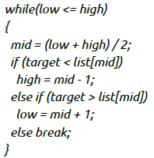
Complexity
This is an algorithm to break a set of numbers into halves, to search a particular field.
Now, this algorithm will have a Logarithmic Time Complexity. The running time of the algorithm is proportional to the number of times N can be divided by 2 (N is high-low here). This is because the algorithm divides the working area in half with each iteration.

Slide 29
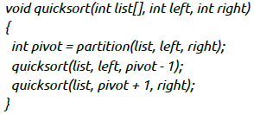
Complexity
Taking the previous algorithm forward, above we have a small logic of Quick Sort (we will study this in detail later). Now in Quick Sort, we divide the list into halves every time, but we repeat the iteration N times(where N is the size of list).
Hence time complexity will be N*log( N ). The running time consists of N loops (iterative or recursive) that are logarithmic, thus the algorithm is a combination of linear and logarithmic.

Slide 30
Complexity
Note:
In general, doing something with every item in one dimension is linear.
Doing something with every item in two dimensions is quadratic, and
Dividing the working area in half is logarithmic.

Slide 31
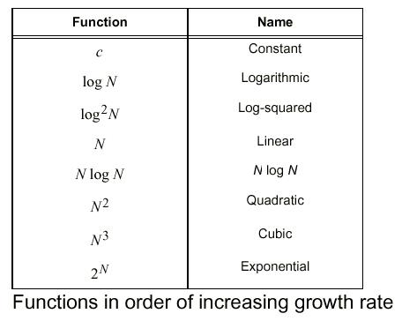
Complexity: Function of Growth rate

Slide 32
Complexity
Time for an algorithm to run t(n):
A function of input. However, we will attempt to characterize this by the size of the input. We will try and estimate the WORST CASE, the BEST CASE, and the AVERAGE CASE.
Worst Case:
is the maximum run time, over all inputs of size n. That is, we only consider the "number of times the principle activity of that algorithm is performed".
Best Case:
In this case, we look at specific instances of input of size n. For example, we might get best behavior from a sorting algorithm if the input to it is already sorted.

Slide 33
Complexity
Average Case:
Arguably, average case is the most useful measure.
Since the algorithm's performance may vary with different types of input data, hence for an algorithm we usually use the worst-case Time complexity of an algorithm because that is the maximum time taken for any input size.

Slide 34
Complexity
Types of Notations for Time Complexity:
1) Big Oh denotes "fewer than or the same as" <expression> iterations (worst-case).
2) Big Omega denotes "more than or the same as" <expression> iterations.
3) Big Theta denotes "the same as" <expression> iterations.
4) Little Oh denotes "fewer than" <expression> iterations.
5) Little Omega denotes "more than" <expression> iterations.

Slide 35
Complexity
Understanding Notations of Time Complexity with Example:
O(expression) is the set of functions that grow slower than or at the same rate as expression.
Omega(expression) is the set of functions that grow faster than or at the same rate as expression.
Theta(expression) consist of all the functions that lie in both O(expression) and Omega(expression).
Suppose you've calculated that an algorithm takes f(n) operations, where,
f(n) = 3*n^2 + 2*n + 4. // n^2 means square of n
Since this polynomial grows at the same rate as n^2, then you could say that the function f lies in the set Theta(n^2). (It also lies in the sets O(n^2) and Omega(n^2) for the same reason.)

Slide 36
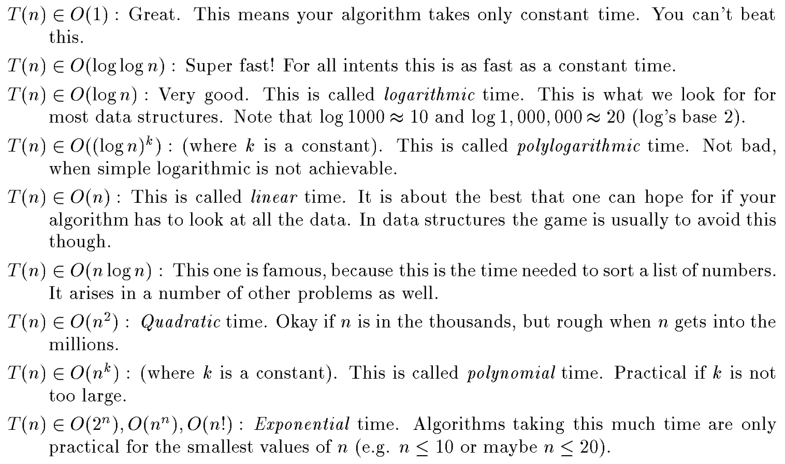
Complexity

Slide 37
Thank You

